Slide 1





Covid-19 dashboard
By: The hAPI Campers
Alon
Terry
Kat
Leticia
Justin

Slide 2
Motivation
COVID-19 is adversely affecting the entire world
The virus can lead to death, but many have recovered
Our goal is to visualize some statistics behind COVID in a dynamic way
Statistics we chose include the number of:
Confirmed Cases
Deaths
Recoveries

Slide 3
LIMITATIONS
Mostly Static Data
Download data from a specific point in time
Upload data to DB
To refresh, we needed to repeat the steps above
Dirty Data
Map
Number of cases to determine the size of the circle, but some states had zeros, which required coding to omit
Lat/Lon/Size of Circle
Data format was string; had to convert to numbers
Data Schema
Had to convert from CSV to Dictionary so that we could process it as a JSON
Data Source
Multiple data sources available with different statistics
Flask App
Primary Key

Slide 4
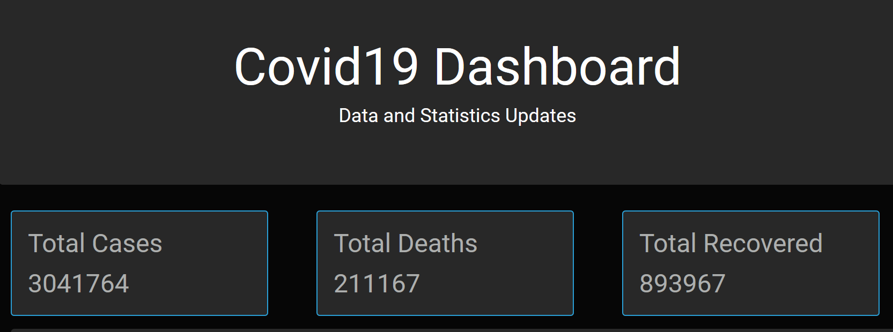
Summary of global data
Death Rate: ~7%
Recovery Rate: ~29%

Slide 5
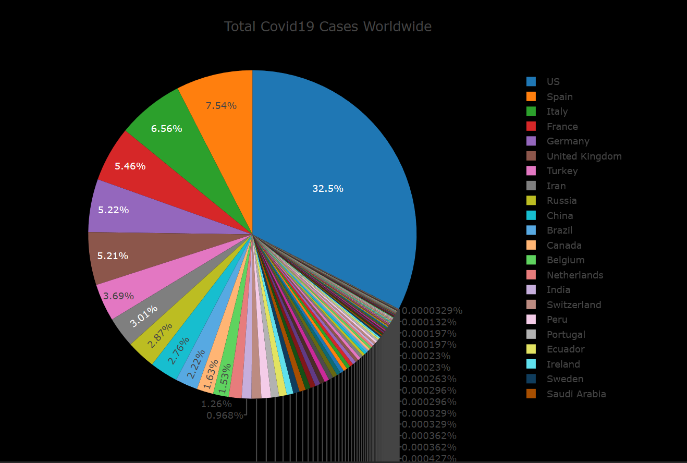
Distribution of cases worldwide
United States
Nearly 1/3 of cases
Spain, Italy, France, Germany, UK, Turkey
1/3 of cases

Slide 6
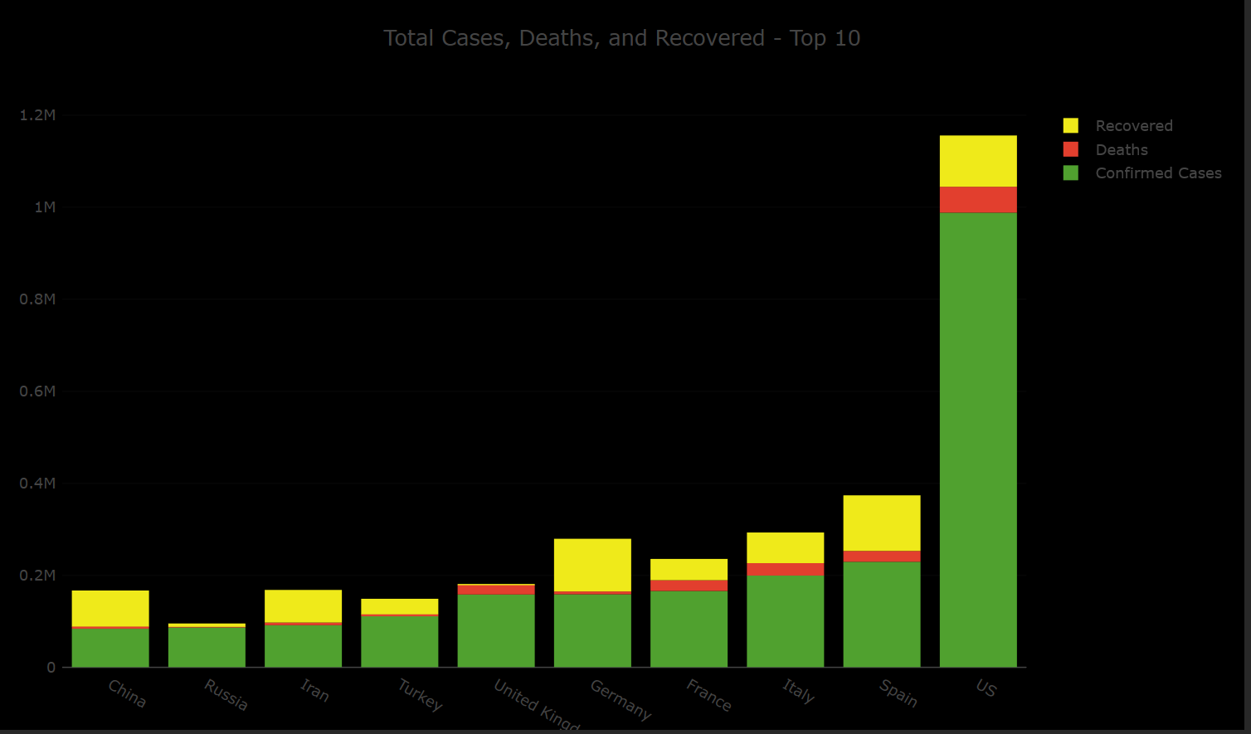
Top 10 affected countries

Slide 7
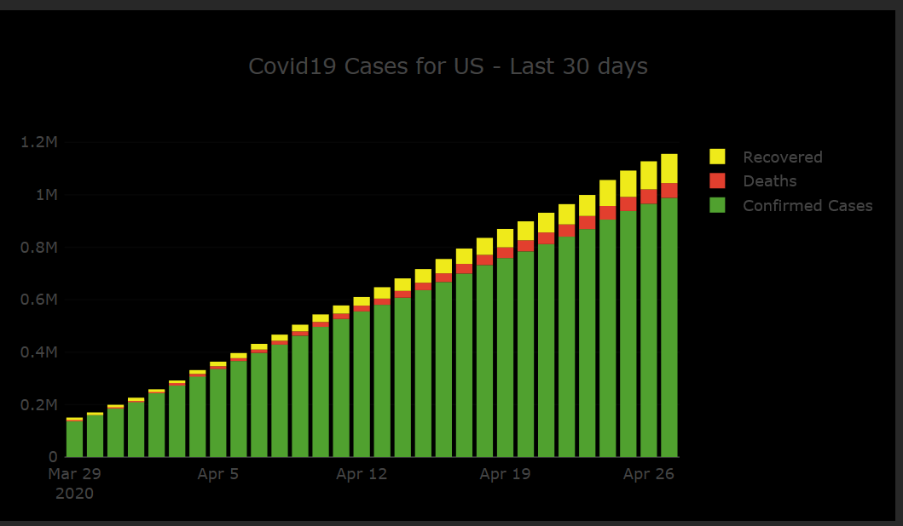
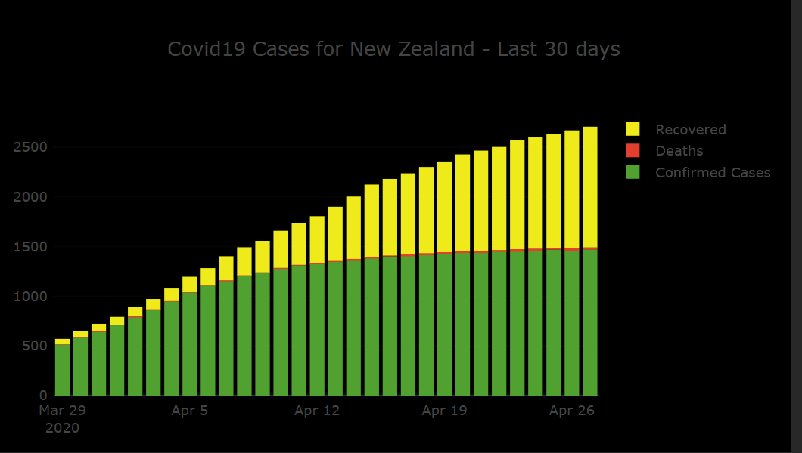
Are we flattening the curve?

Slide 8
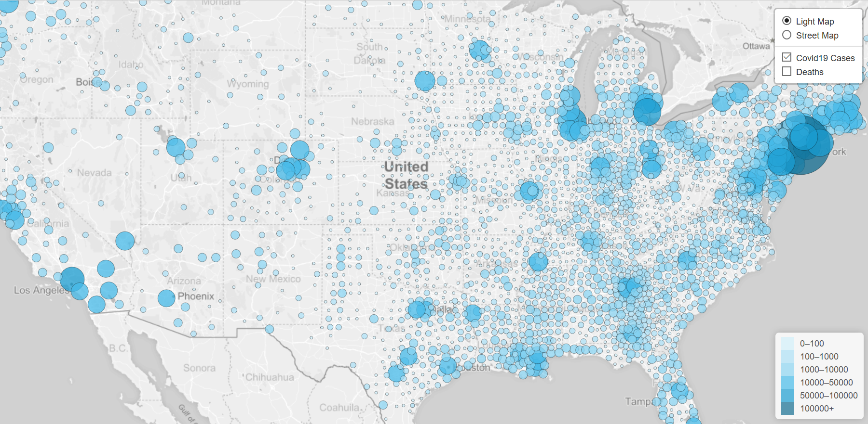
Heat map: United States Cases

Slide 9
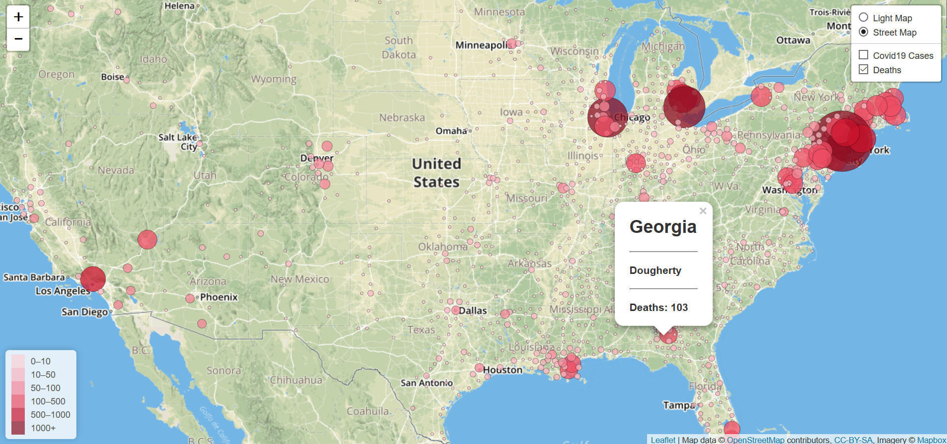
Heat map: United States deaths

Slide 10
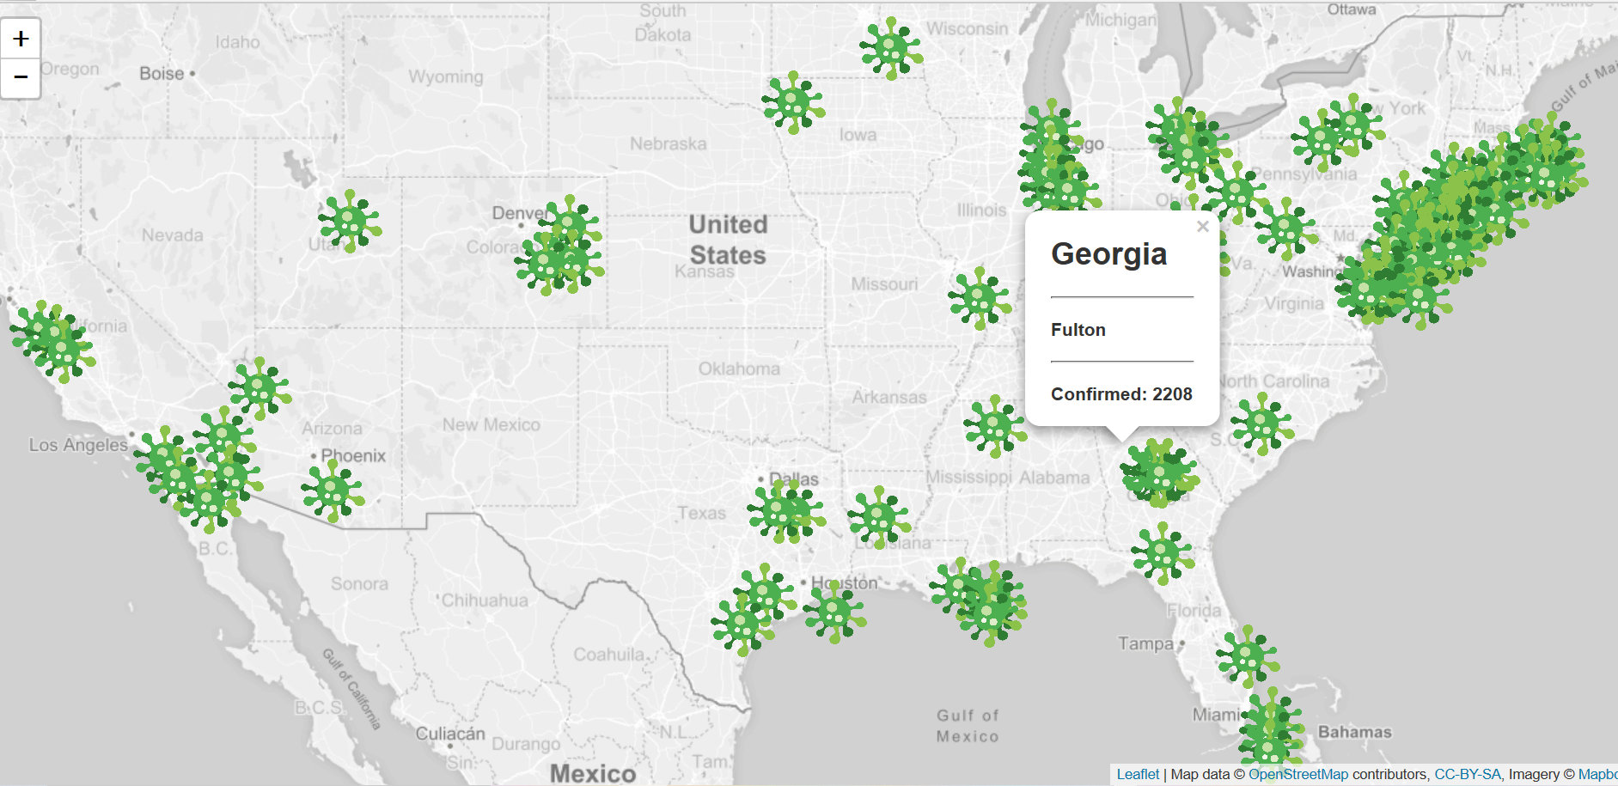
Counties with >1K cases

Slide 11
Post Mortem
Additional Questions & Further Research
How does this data compare to flu data if we put it side-by-side?
Given more time, we could compare a few datasets to test the accuracy
Does social distancing really help? Some states enacted measures before other states, but the spread of the virus was not alike (California)
Geographical factors play a major role in the effectiveness of distancing
What would the data look like if COVID was around for a longer period?

